Slide 1

BASIS DATA - TI14KB21
Meeting 9
Structured Query
Language (SQL)
Bagus Kristomoyo Kristanto S.Kom , M.MT
bagus.kristanto@stiki.ac.id

Slide 2
Outline
01
Explore basic commands and functions of SQL
How to use SQL for data administration (to create tables, indexes, and views)
02
03
How to use SQL for data manipulation (to add, modify, delete, and retrieve data)

Slide 3
Introduction to SQL
SQL functions fit into two broad categories:
Data definition language
SQL includes commands to:
Create database objects, such as tables, indexes, and views
Define access rights to those database objects
Data manipulation language
Includes commands to insert, update, delete, and retrieve data within database tables

Slide 4
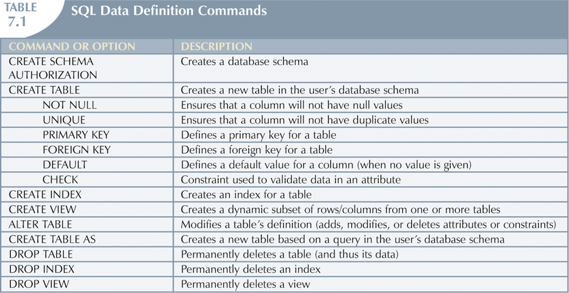
Introduction to SQL

Slide 5
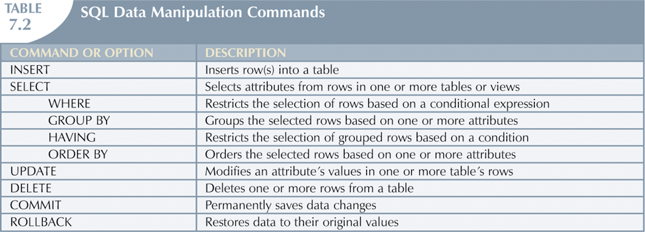
Introduction to SQL

Slide 6
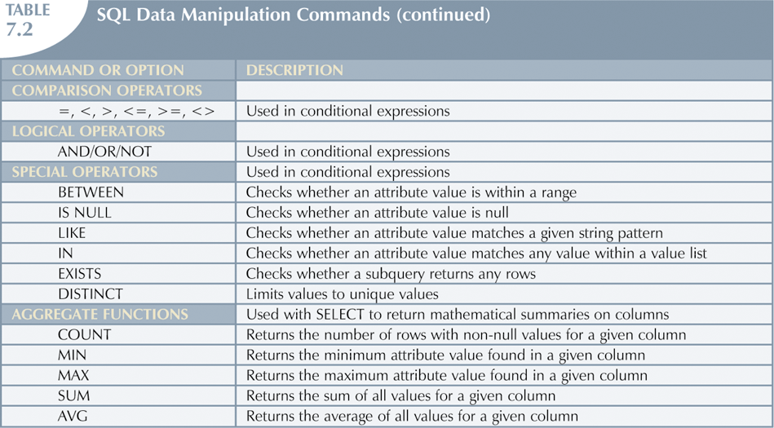
Introduction to SQL

Slide 7
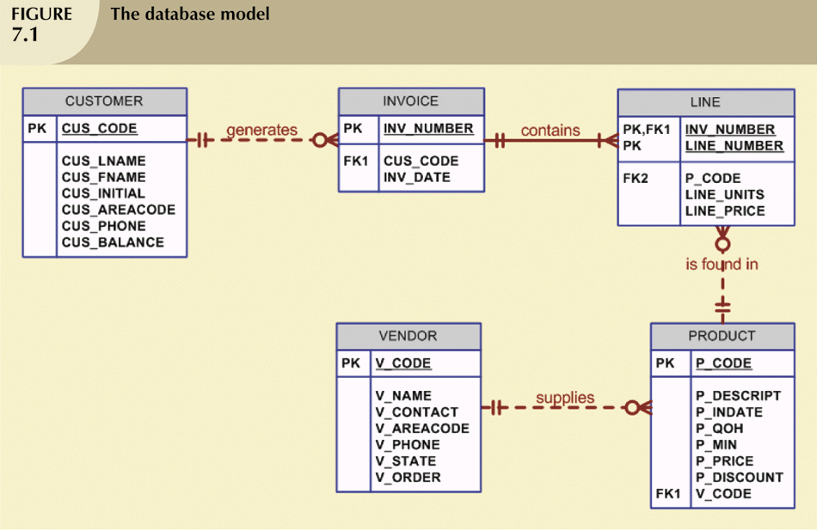
Data Definition Commands
Examine simple database model and database tables that will form basis for many SQL examples
Understand data environment

Slide 8
Creating the Database
Following two tasks must be completed:
Create database structure
Create tables that will hold end-user data
First task:
RDBMS creates physical files that will hold database
Tends to differ substantially from one RDBMS to another

Slide 9
The Database Schema
Authentication
Process through which DBMS verifies that only registered users are able to access database
Log on to RDBMS using user ID and password created by database administrator
Schema
Group of database objects—such as tables and indexes—that are related to each other

Slide 10
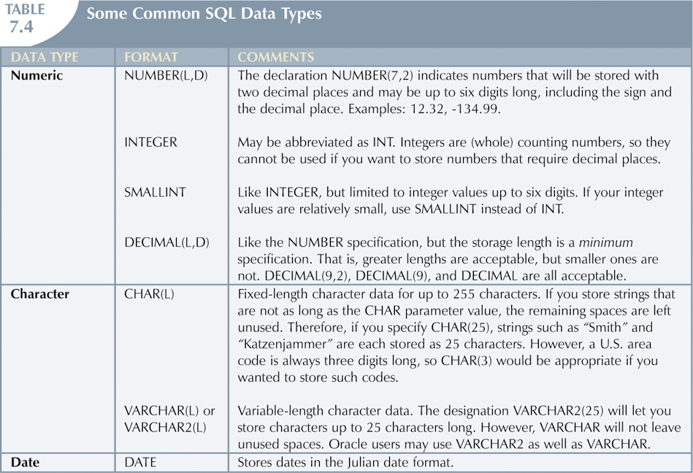
Data Types
Data type selection is usually dictated by nature of data and by intended use
Pay close attention to expected use of attributes for sorting and data retrieval purposes

Slide 11
Creating Table Structures
Use one line per column (attribute) definition
Use spaces to line up attribute characteristics and constraints
Table and attribute names are capitalized
NOT NULL specification
UNIQUE specification
Primary key attributes contain both a NOT NULL and a UNIQUE specification
RDBMS will automatically enforce referential integrity for foreign keys
Command sequence ends with semicolon

Slide 12
SQL Constraints
NOT NULL constraint
Ensures that column does not accept nulls
UNIQUE constraint
Ensures that all values in column are unique
DEFAULT constraint
Assigns value to attribute when a new row is added to table
CHECK constraint
Validates data when attribute value is entered

Slide 13
SQL Constraints
When primary key is declared, DBMS automatically creates unique index
Often need additional indexes
Using CREATE INDEX command, SQL indexes can be created on basis of any selected attribute
Composite index
Index based on two or more attributes
Often used to prevent data duplication

Slide 14
Data Manipulation Commands
Adding table rows
Saving table changes
Listing table rows
Updating table rows
Restoring table contents
Deleting table rows

Slide 15
Adding Table Rows
INSERT
Used to enter data into table
Syntax:
INSERT INTO columnname VALUES (value1, value2, … , valuen);

Slide 16
Adding Table Rows
When entering values, notice that:
Row contents are entered between parentheses
Character and date values are entered between apostrophes
Numerical entries are not enclosed in apostrophes
Attribute entries are separated by commas
A value is required for each column
Use NULL for unknown values

Slide 17
Saving Table Changes
Changes made to table contents are not physically saved on disk until, one of the following occurs:
Database is closed
Program is closed
COMMIT command is used
Syntax:
COMMIT [WORK];
Will permanently save any changes made to any table in the database

Slide 18
Listing Table Rows
SELECT
Used to list contents of table
Syntax:
SELECT columnlist FROM tablename;
Columnlist represents one or more attributes, separated by commas
Asterisk can be used as wildcard character to list all attributes

Slide 19
Updating Table Rows
UPDATE
Modify data in a table
Syntax:
UPDATE tablename SET columnname = expression [, columname = expression] [WHERE conditionlist];
If more than one attribute is to be updated in row, separate corrections with commas

Slide 20
Restoring Table Contents
ROLLBACK
Used to restore database to its previous condition
Only applicable if COMMIT command has not been used to permanently store changes in database
Syntax:
ROLLBACK;
COMMIT and ROLLBACK only work with data manipulation commands that are used to add, modify, or delete table rows

Slide 21
Deleting Table Rows
DELETE
Deletes a table row
Syntax:
DELETE FROM tablename [WHERE conditionlist ];
WHERE condition is optional
If WHERE condition is not specified, all rows from specified table will be deleted

Slide 22
Thank you

